Slide 1
Inlustro Final Project - Heart Disease Classification
College Name:
Department Name:
Presenters:
Saranathan College of Engineering
Computer Science and Engineering
S.Reneil Joshua(241075)
S.Sudarsan(241103)
B.R.Surendran(24105)
S.Vignesh(241120)

Slide 2
INTRODUCTION
Coronary Heart Disease (CHD) remains a critical global health concern, responsible for a substantial portion of cardiovascular-related morbidity and mortality. Identifying individuals at risk of developing CHD is paramount for timely intervention and prevention efforts. This project aims to harness the power of data analysis and predictive modeling to better understand the factors associated with Ten-Year CHD risk and to build a reliable predictive model.

Slide 3
DATASET DESCRIPTION
The dataset under investigation contains information on individuals, including features such as age, education level, gender, smoking status, and various health-related measurements (e.g., cholesterol levels, blood pressure, BMI, and glucose levels). The dataset also includes a crucial target variable, "TenYearCHD," which indicates whether an individual is at risk of developing CHD within the next ten years (1 for at risk, 0 for not at risk).

Slide 4
SIGNIFICANCE
This project's significance lies in its potential to contribute to early CHD risk assessment, which can enable targeted interventions and lifestyle modifications for at-risk individuals. Moreover, it underscores the importance of data-driven approaches in healthcare decision-making and highlights the relevance of predictive modeling in preventive medicine.
In the following sections, we will delve into the dataset, conduct rigorous analysis, build predictive models, and ultimately aim to enhance our understanding of the factors influencing Ten-Year CHD risk.

Slide 5
DATA PREPROCESSING
Data distribution
Age: It follows a normal distribution, indicating symmetrical variation among the age intervals.
Education: It exhibits a positively skewed distribution, suggesting a lack of symmetry in the data.
Total Cholesterol (totChol), Systolic Blood Pressure (sysBP), Diastolic Blood Pressure (diaBP), and BMI (Body Mass Index): These variables follow a normal distribution, showing symmetrical differences, and no outliers are present in the data.
Heart rate and glucose levels follow a normal distribution, but outliers are present in the data.
Checking for Missing Values
The feature 'glucose' stands out with the highest missing data percentage, approximately 9%. While some other features have minimal missing data.

Slide 6
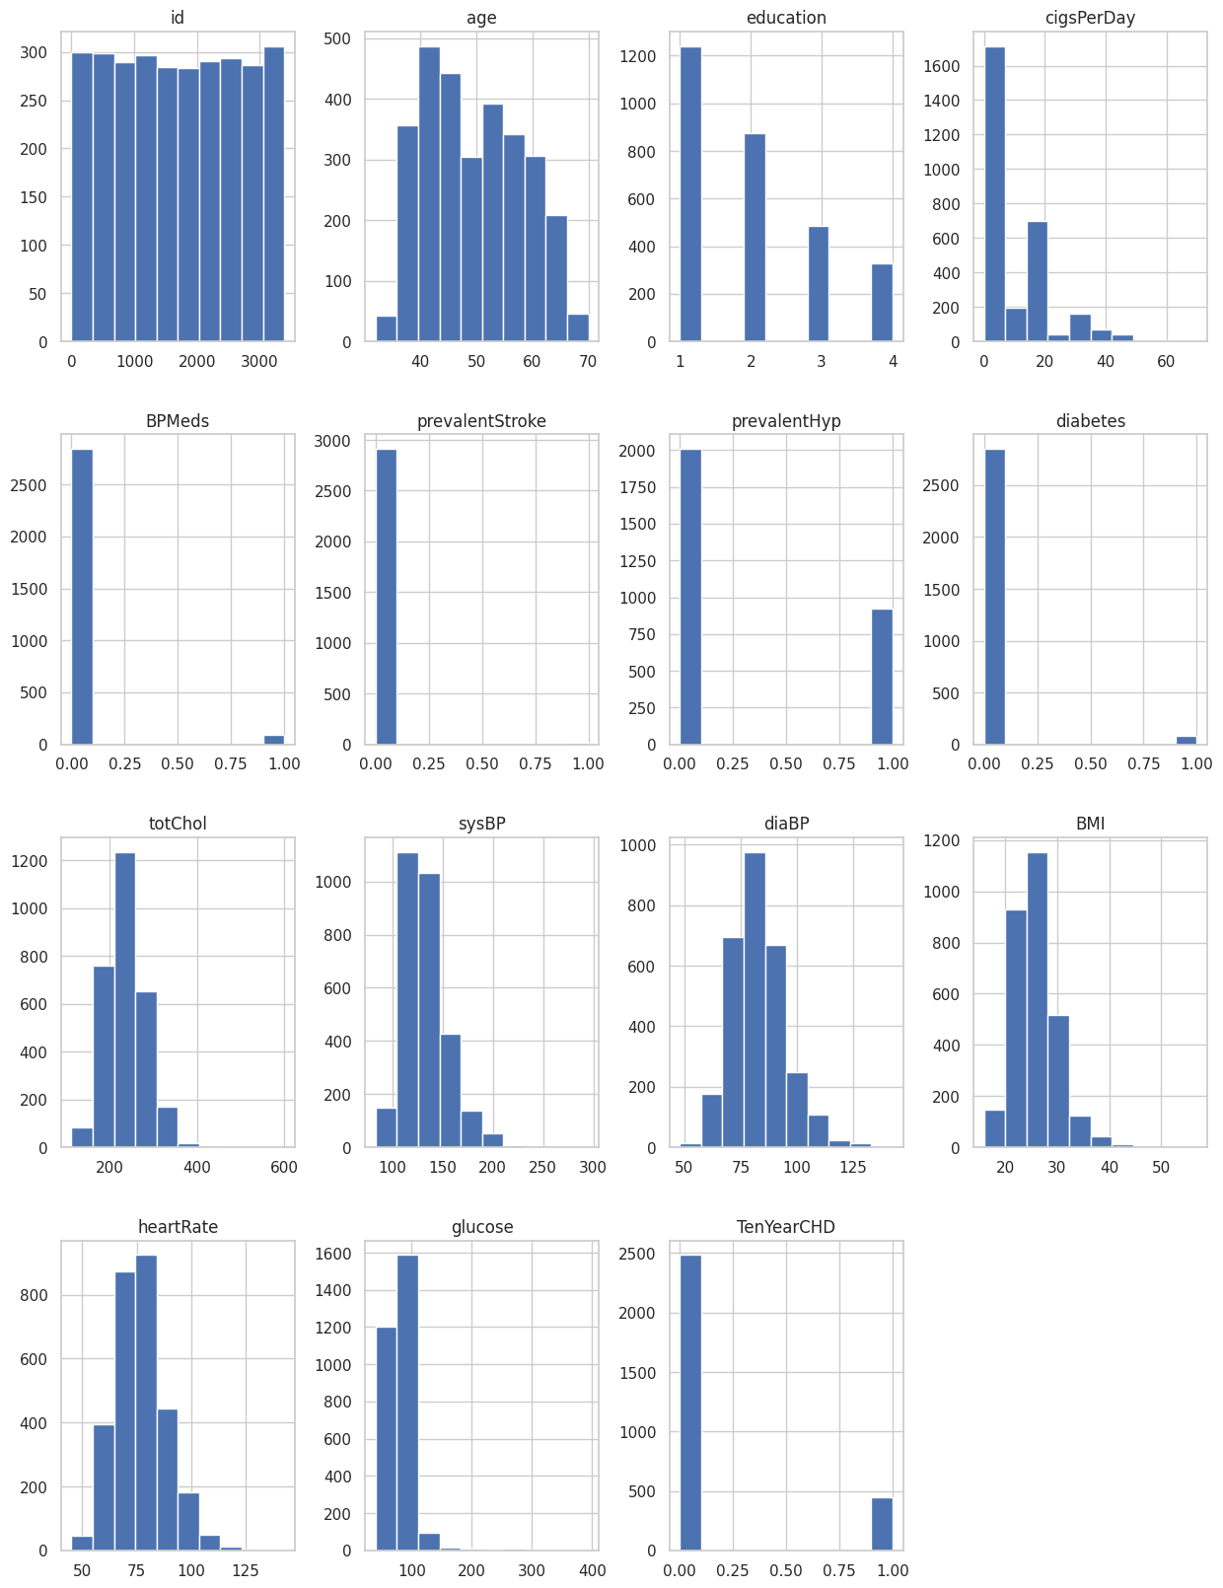
Exploratory Data Analysis
Univariant Analysis

Slide 7
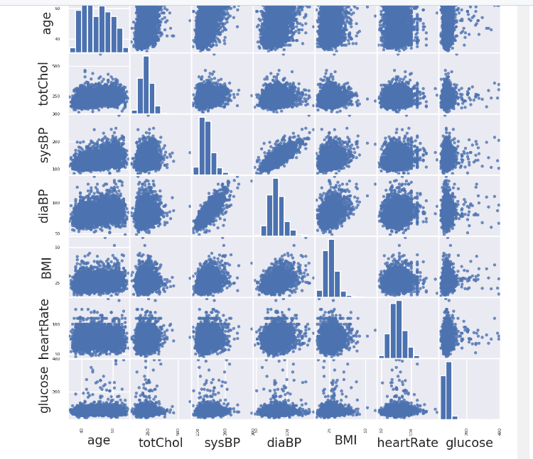
Bivarient analysis

Slide 8
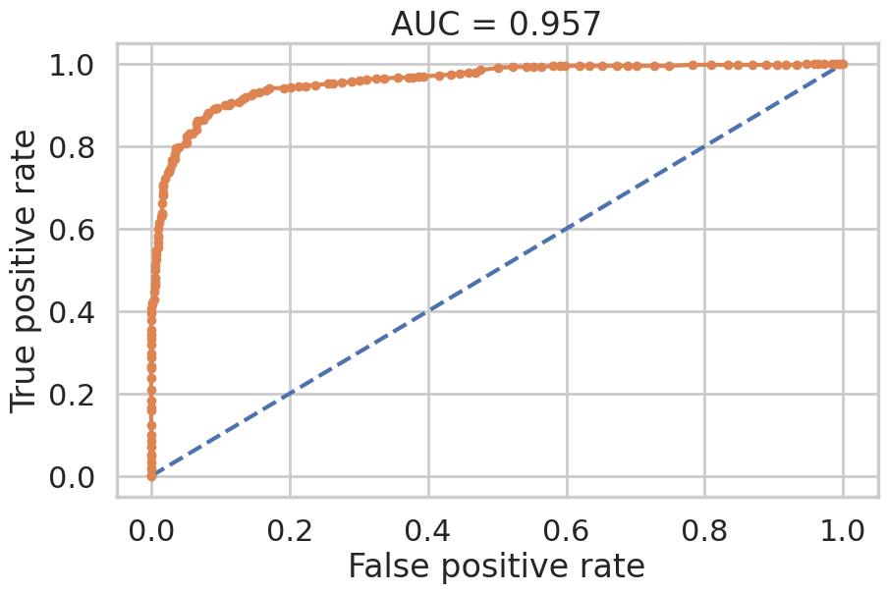
Results

Slide 9
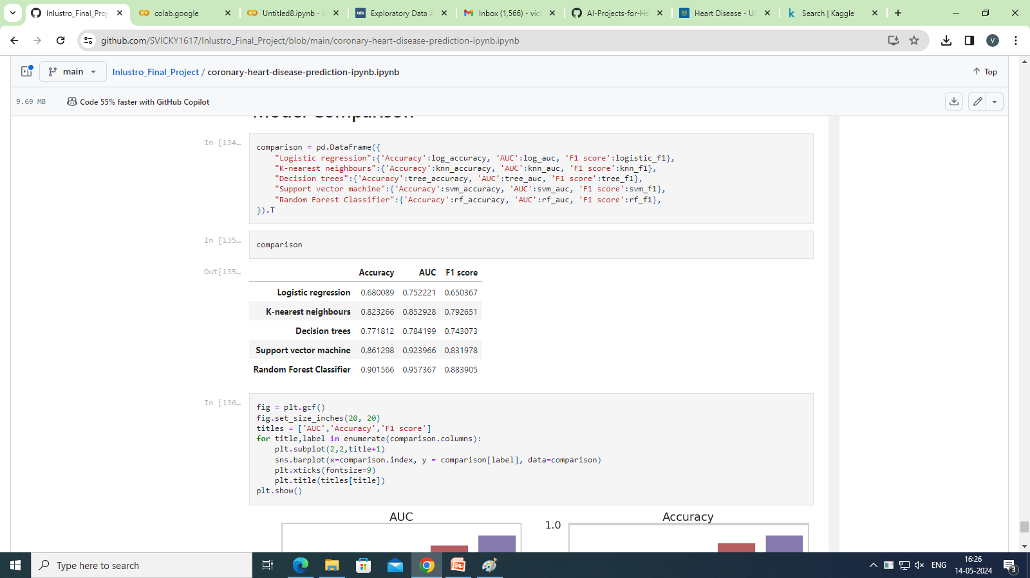
Model Comparision

